Slide 1
Ongoing Recovery Program
The September 11th Fund

Slide 2
The September 11th Fund has made a difference
45,000 individuals and families received checks
Job assistance for more than 17,000
Free mental health for tens of thousands
Legal help for thousands
Hot meals, equipment and supplies for Thousands of rescue workers

Slide 3
Ongoing Recovery Program:
Continuing to Help, But in a Better Way
Help meet the needs of as many as possible
Meet needs that others don’t – Fill Gaps
Gives people choices where and how to get help
Make it as easy as possible to access services

Slide 4
Who We Help
Surviving families
Injured
Witnesses/Evacuees
Displaced workers
Displaced residents
Kids and schools affected by attacks
Small businesses and nonprofits

Slide 5
Continuing to Meet Needs
Mental health & counseling
Employment assistance
Health
Coordination & Referral
Kids & Schools
Small businesses and nonprofits
Legal & financial advice
Cash assistance

Slide 6
Coordinating with Government & Other Charities
Federal Emergency Management Agency
NYS Crime Victims Board
SBA/HUD
American Red Cross
Robin Hood Relief Fund

Slide 7
Expanded Area of Eligibility for Economic Aid
Now includes
  Area north of Canal to Delancey, Essex to Broadway
  National Airport
Expanded help for
  Displaced workers
  Small businesses

Slide 8
Coordination & Referral
Available to families, dislocated residents & workers. Service coordinators help show what services are available and access them.
Currently 200 trained service coordinators in NY, NJ, CT, DC. 9/11 USG is training more.
Projected Fund cost: $20 million (3–5 years for families, 1 year for residents & workers).

Slide 9
Health
For t hose who cannot afford private health insurance and are not eligible for public programs (est. 22,500)
Funding: 12 months of comprehensive services including mental health.
Major insurers include Affinity Health Plan, Horizon Blue Cross Blue Shield
Projected $40-45 million

Slide 10
Mental Health
For those who do not have another source of support (est. 15,000)
Funding: 12 months (anticipate renewal) to fully reimburse for treatment.
Grantees include Mental Health Assn. & American Case Management.
Projected: $45 million

Slide 11
Employment Assistance
To help unemployed/underemployed find jobs and build skills
Funding: 12 months for full range of employment services, income support and wage subsidies
Grantees in NY, NJ & DC area
Projected: $60 million

Slide 12
Kids & Schools
For educators and students from 19 NYC and NJ schools that witnessed/were impacted by attacks
Funding: 1-5 years for mental health, academic development enrichment and professional development
Public and nonprofit grantees
Projected: $10-15 million

Slide 13
Small Businesses & Nonprofits
For those who don’t qualify for government or private support
Funding: From six months to five years for grants and loans
Grantees include Seedco, ACCION, NYC Partnership, Nonprofit Finance Fund
Projected: $26 million

Slide 14
Legal and Financial
Provides information and outreach about federal compensation and other legal needs
Funding: (ask Tim)
Grantees include Trial Lawyers Care, Bar Associations & Legal Aid
Projected: $10 million

Slide 15
Cash Assistance
Still available for surviving families and severely injured
Funding through Safe Horizon
Projected: $10 million

Slide 16
Key Points
The September 11th Fund continues to make a difference. Continuing to meet needs.
New and improved program
Focuses on needs of individuals & families
Coordinated with government and other charities to meet needs others don’t
Gives choices about where & how to get help, and
Makes it easier to get help

Slide 17
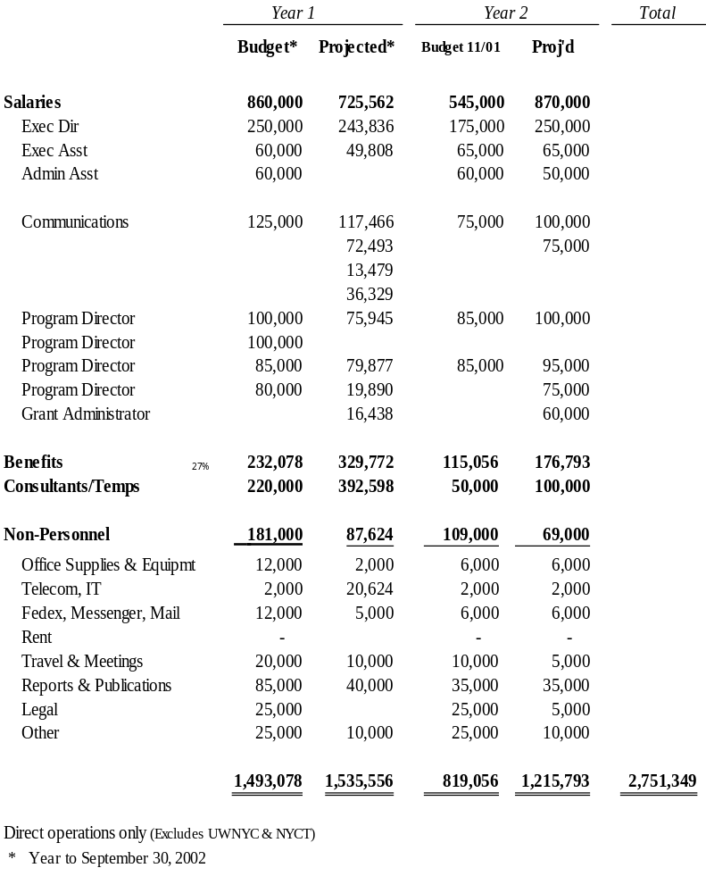
Potential Revisions to Administrative Budget
September 11th Fund has been operated as a small organization, relying on services donated by NYCT, UWNYC and others.
Original budget assumed program development and grantmaking largely complete in first year. Second year activity primarily for monitoring with reduced staff.
First year totals should be consistent with budget. However, communications expenses were much more than budgeted; these were offset by in-kind contributions for program development and other costs.
In light of this year’s experience, recommend greater Year 2 budget amounts than previously planned for program staff and communication.

